Slide 1
03/10/25
The Alliance
and Its Student Community
Lukáš Langer
Zuzana Přívratská

Slide 2
Contents
01.
What Is 4EU+
02.
How It Works
03.
Opportunities for Students
04.
Synergy Projects and Funding
05.
Student Network and Community

Slide 3

01
What Is 4EU+?

Slide 4
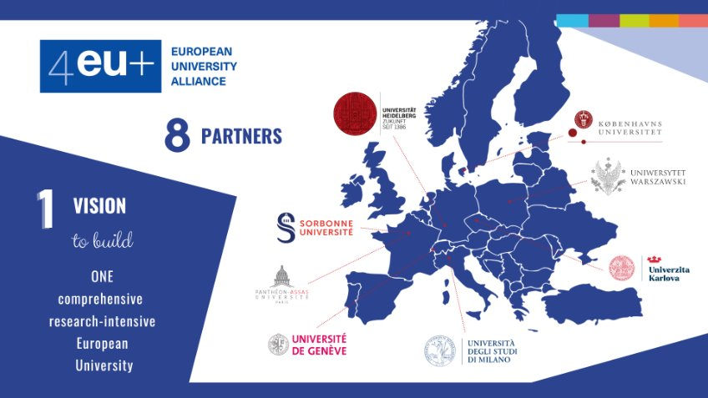


Slide 5
4EU+ Alliance
General Information

Slide 6

Strategic partnership
Established in 2018 and connecting eight European universities.
Integration in all areas
Counting education, science, administration and so on.
Sharing best practices
Including innovation, networking, research cooperation.
Connecting
Students, academic and administrative staff, infrastructure, data…

Slide 7

Short History
Originally 4EU, the Alliance was founded in March 2018 by Charles University (CzechRepublic), Heidelberg University (Germany),Sorbonne University (Paris, France), and theUniversity of Warsaw (Poland).
In October 2018 it became 4EU+ with theaddition of the University of Copenhagen (Denmark) and the University of Milan(Italy). ​
In August 2022, the University of Geneva (Switzerland) joined 4EU+.​
In July 2023, the Paris-Panthéon-Assas University joined 4EU+.​

Slide 8

02
How It Works?

Slide 9
4EU+
VISION
4EU+
MISSION
4EU+
BENEFITS
Our vision is to create One Comprehensive Research European University.
Our mission is to continuously deepen cooperation in education, research and innovation.
Our purpose is to also provide students benefits like studying abroad or deepening their expertise.

Slide 10
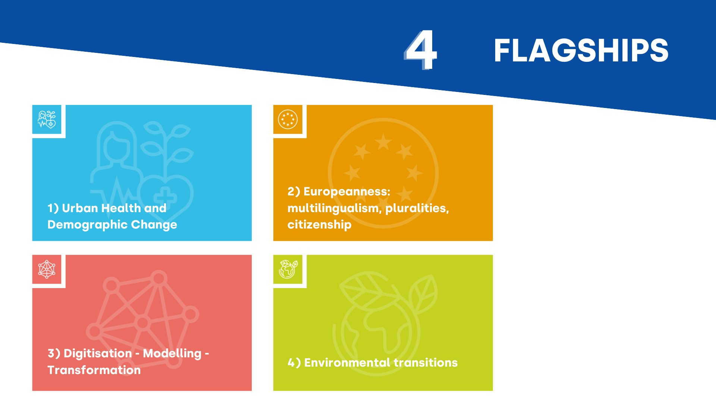
4 FLAGSHIPS

Slide 11

Strategy 2025-2035
One Comprehensive Research-Intensive European University
long-term roadmap, focusing on deepening cooperation in four key areas: education, research, innovation, and global outreach
https://4euplus.eu/4EU-1001.html

Slide 12

03
Opportunities for Students

Slide 13
Opportunities
4EU+ mobility
4EU+ Synergy Projects
4EU+ Student Community

Slide 14
4EU+Synergy
4EU+Bridging
Special funding
Academic and student projects
Academic and student mobilities from CU
Strategically Important 4EU+ Projects
Rector’s Measure No. 4/2026

Slide 15
4EU+Bridging
intended for staff and students of Charles University
short-term visits to partner universities or to represent the 4EU+ Alliance externally
These visits take place independently of other approved 4EU+ projects. 4EU+Bridging does not serve as a replacement for Erasmus+, the Mobility Fund, etc.
Funding is provided exclusively for travel expenses related to the visit.
Calls for 4EU+ Bridging Project proposals are held four times a year, covering the two subsequent quarters
  1–15 March for visits starting between 1 April – 30 September
  1–15 June for visits starting between 1 July – 31 December
  1–15 September for visits starting between 1 October – 31 March
  1–15 December for visits starting between 1 January – 30 June

Slide 16
4EU+Bridging
WHO CAN APPLY?
  Academic and administrative staff of Charles University (with an employment contract at CU)
  Students of Charles University (full-time or part-time, all levels of study)
FUNDING AND CONDITIONS
  Funding covers travel expenses only, in accordance with the approved rates specified in the Rules for the use of 4EU+ funding
  For Charles University employees, funding is provided in the form of an official business trip
  For Charles University students, funding is provided as a mobility grant stipend
SUPPORTED ACTIVITIES
  Visits to partner universities of the 4EU+ Alliance
  Participation in activities representing the Alliance outside partner universities

Slide 17
Projects must align with the 4EU+ Strategy 2025–2035
Projects must correspond to one of the four selected thematic areas (Flagships)
Project applications must be submitted via online form
https://cuni.cz/UK-15415.html
Project application must include:
Acceptance letter
Programme of the visit
For employees: approval from supervisor
For students projects: 4EU+ Learning Agreement

Slide 18

04
Synergy Projects/Funding

Slide 19
4EU+Synergy
institutional support provided by Charles University
project teams must consist of colleagues from at least three partner universities, with Charles University acting as the coordinating institution
academic and student joint research, educational, and innovation activities
Applications may be submitted twice a year, by 15 April and 15 October
project duration may range from 12 to 36 months (the project end date must fall within the period 1 January – 31 August)

Slide 20
4EU+Synergy
WHO CAN APPLY?
  Academic staff of Charles University employed at a minimum of 0.5 FTE
  Students of Charles University (full-time or part-time, across all levels of study)
AMOUNT OF SUPPORT
  up to CZK 300,000 for 12 months of project duration (academic projects)
  up to CZK 150,000 for 12 months of project duration (student projects)
  Budget is allocated to the team at Charles University, it may also be used to cover travel costs for partners to Czech Republic. Budget must be broken down into calendar years.
  Funds may be used in accordance with the harmonized rules for the utilization of funds and reimbursement of expenses for 4EU+ projects for travel expenses, personnel costs, and other costs
SUPPORTED AREAS
  research and science
  education
  innovation
  activities with global outreach and the university’s “third mission”

Slide 21
Projects must align with the 4EU+ Strategy 2025–2035
Projects must correspond to one of the four selected thematic areas (Flagships)
Project applications must be submitted via online form
https://cuni.cz/UK-15414.html
Project application must include:
Confirmation of partner involvement
Confirmation from your faculty
Budget table
For students projects: approval from the supervisor/programme guarantor

Slide 22




WHAT IS EVALUATED?
Project quality
Strategy
Feasibility
Sustainibility
Quality and novelty of the project
Alignment with the strategic objectives of Charles University and the 4EU+ Strategy, including partner involvement
Feasibility of the objectives and appropriateness of the budget
Planned sustainability and continuation of the project

Slide 23
Submit an application with all attachments
We recommend that you ALWAYS consult your faculty coordinator about the project plan and budget
The budget must be planned carefully and specifically. In the budget table, it will be necessary to break down the budget into calendar years. It is necessary to think everything through, as major changes will not be possible later on.
Alignment with the 4EU+ Strategy
What should you pay attention to?

Slide 24
Special Funding for Strategically Important 4EU+ Projects
WHO CAN SUBMIT THE PROPOSAL?
  a member of the Rector’s Board responsible for 4EU+ matters,
  a faculty Vice-Dean responsible for 4EU+ affairs, or
  the university’s representative in one of the 4EU+ Alliance Flagships
Proposals may be submitted outside regular calls.
All information can be found here: https://cuni.cz/UK-15380.html

Slide 25

05
Student Network and Community

Slide 26

Student Network
Group of selected representatives of each faculty trying to promote 4EU+ opportunities to their peers.

Slide 27
Dedicated students serving as the faces and main representatives of each university in the Alliance
Their role involves joining international conferences where they represent their faculties as well as promoting the Alliance in their Academic Community
Typically 2 are selected for a mandate of multiple years
Student Ambassadors

Slide 28
STUDENTS
Student Community
WhatsApp community connecting students with interest in 4EU+
Information
Networking
4EU+ Promotion

Slide 29
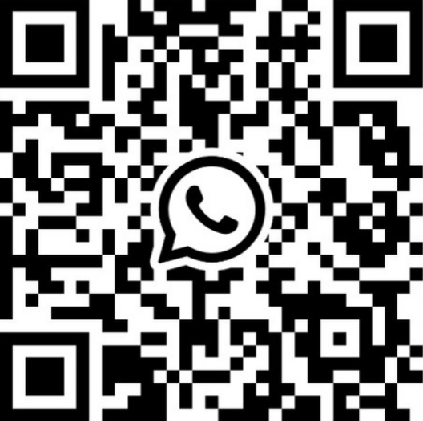
Join the Community TODAY!

Slide 30
Thank You for Your attention!
Any questions?

