Slide 1
Neurobehavioral Science I and II
Psychiatry
Change in teaching venue!
MUDr. Tomáš Novák
Tomas.Novak@nudz.cz

Slide 2
National Institute of Mental Health
Since January 2015 lectures, seminars and practice in psychiatry have been taking place in National Institute of Mental Health (NIMH-CZ).
Address: Topolova 748, 250 67, Klecany, Prague East region.
Public transport connection: Bus No 371 or 374, from the subway station „Kobylisy“ (line „C“) to bus stop „Klecany, U hřbitova“. Duration 14 minutes
Connection and map see next

Slide 3
Public transport connection to NIMH-CZ
Kobylisy (subway st) → Klecany (bus stop „U hřbitova“) – 14min
371 374 | 7.00 | 7.10 | 7.25 | 7.35 | 7.50 | 8.10 | 8.40 | 9.10 | 9.40 | 10.10
Klecany (bus stop „U hřbitova“) → Kobylisy (subway st) - 14min
371 374 | 10.08 | 10.38 | 11.08 | 11.38 | 12.08 | 12.38 | 13.03 | 13.23 | 13.48 | 14.18
Outside Prague tariff zone (12 CZC plus P 0,1,B)
For details see www.dpp.cz

Slide 4
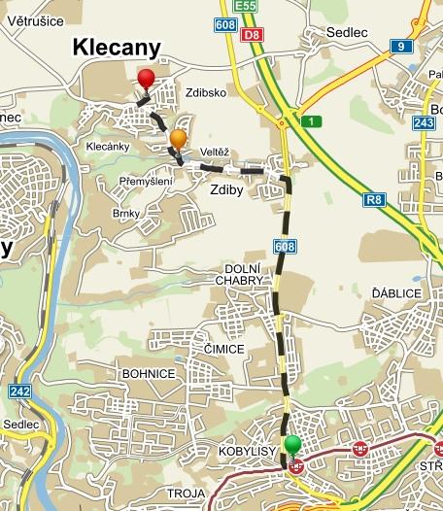
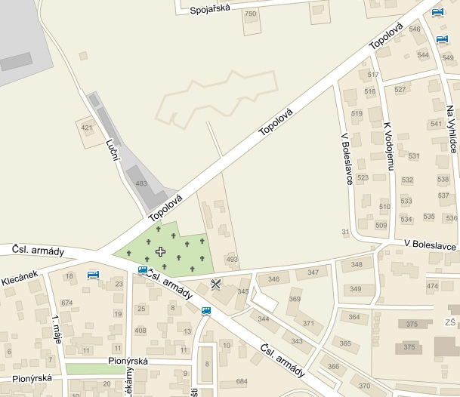
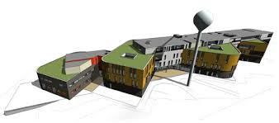
Map
NIMH-CZ
Bus stop „U hřbitova“ bus No 371, 374

Slide 5
Lecture hall
The lecture hall is situated on the ground floor on the left side from the main entrance.
For Questions: Tomas.Novak@nudz.cz

